Slide 1
Try, Ango！
An Yanru Xie Chengtai
Chen Hongxi Wang Ziyang

Slide 2
Introduction
Index
Index
01
02
Frame
03
Challenges
04
Goal

Slide 3
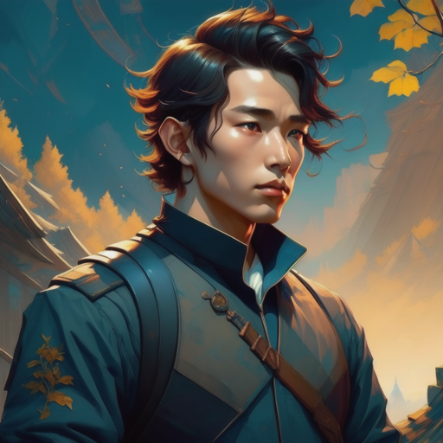
Introduction
The Story
Ango is a learner in an iron shop in a
village.
One day, his master was infected with a strange disease, and the knights of the kingdom sent an order to search for mysterious treasures in the forbidden area of the kingdom.
The young man starts on a legendary
adventure for a generous bonus.

Slide 4

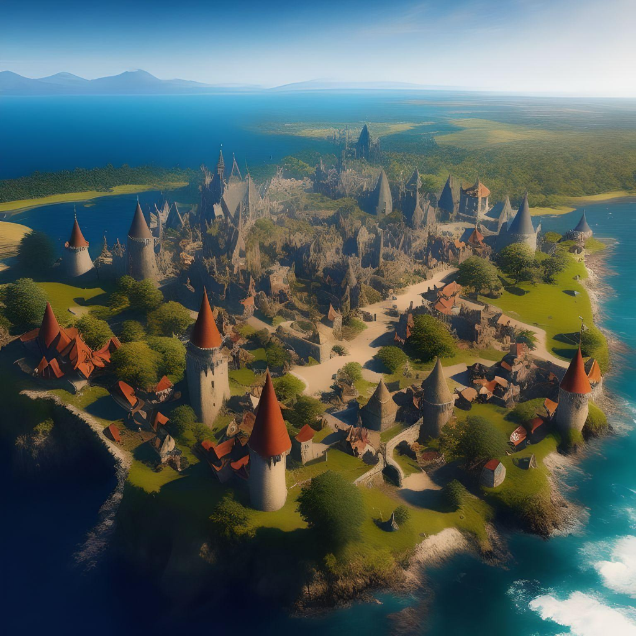
Introduction
The Story
Story begins in an imaginary kingdom
called Singwan, which is a highly develop-ed Kingdom in southeast mainland.
The beautiful environment, pleasant temp-erature and friendly people will make the best opening scene for our games.
And the story is about a triangle in this
kingdom. So try and go, Ango!

Slide 5
02
Frame

Slide 6
What kind is the game?
Solve the puzzles!
Run, jump and act!
Enjoy the adventure and the story!
Well…there’s a problem in front of me…How can I figure the solution?
I have a hammer…Ohhh! I know how to go through!
The problem is destroyed by me with my hammer!

Slide 7
What do we have in the game?
Hero named Ango
Three big scenes with several puzzles
Your goal is to solve the puzzles with your objects, skills and your wisdom!
Many interactive objects in the scene
You will get a new skill after you enter a new scene

Slide 8
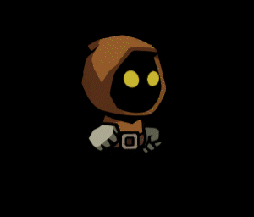
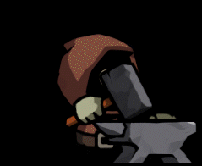


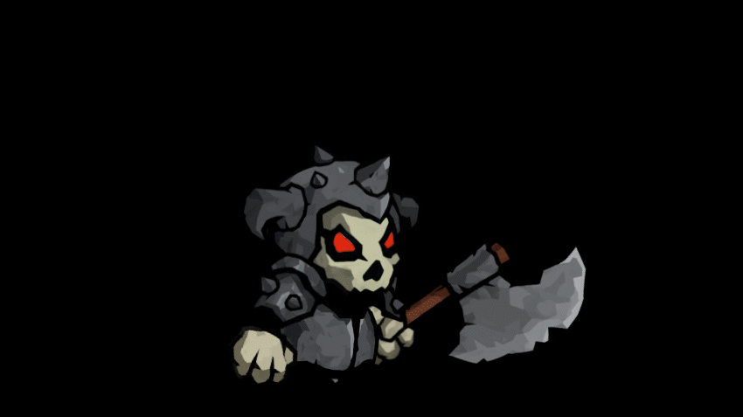

What can Mr.Ango do?
Run
Jump
Double jump
Dash…
Climb
You may face some cute enemies…

Slide 9
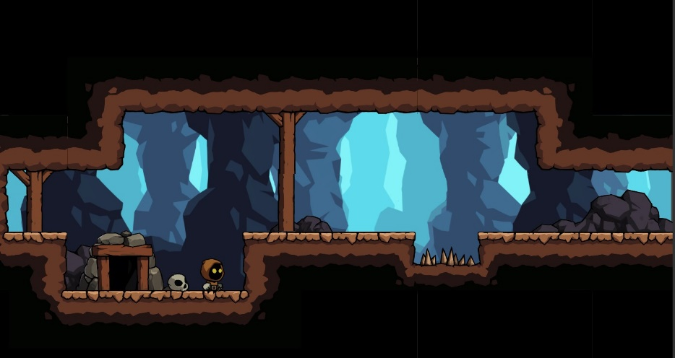
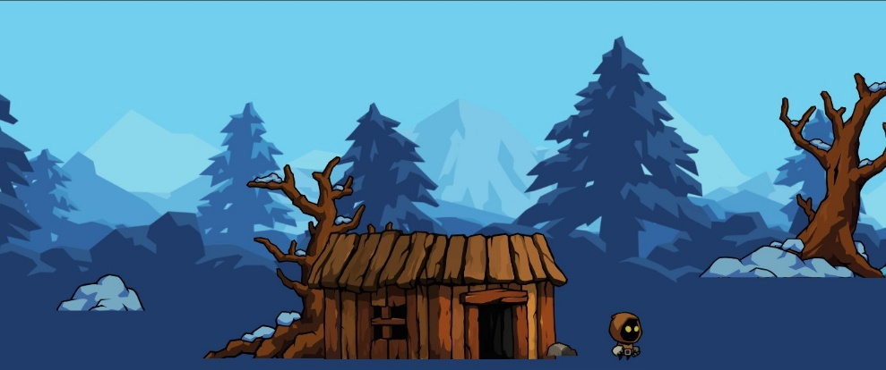
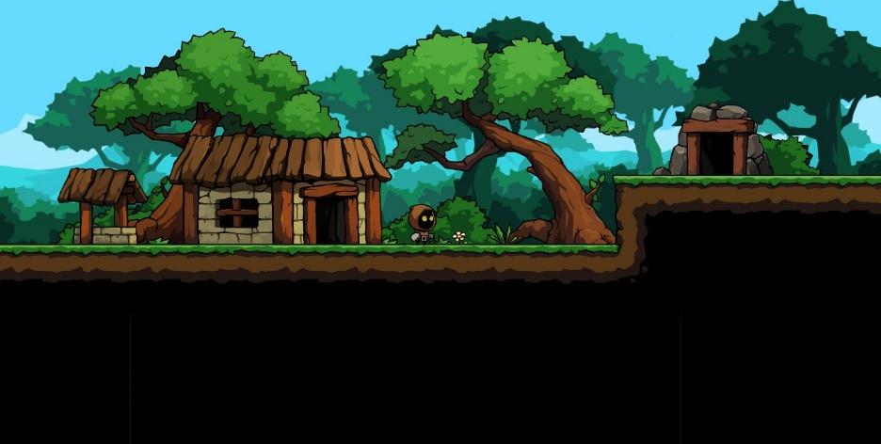
Three big scenes
Cave
Snow mountain
Forest

Slide 10
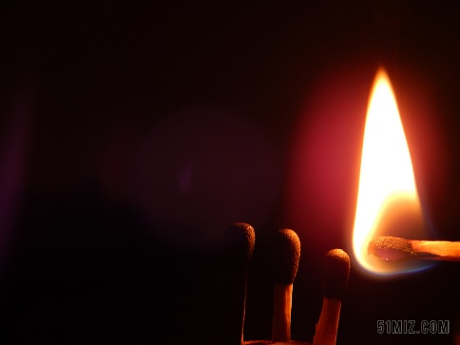
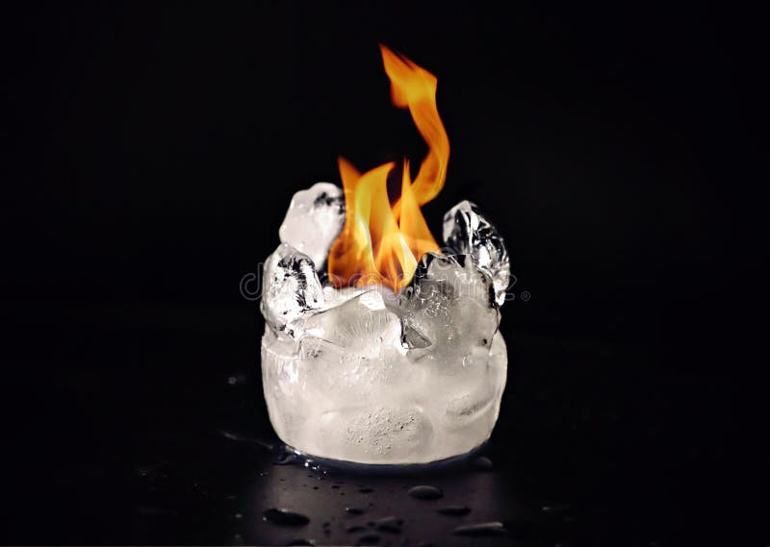

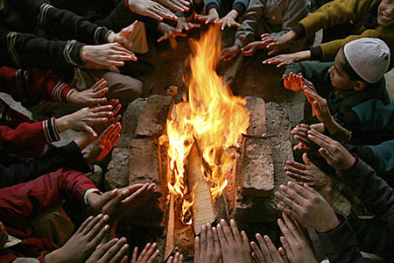
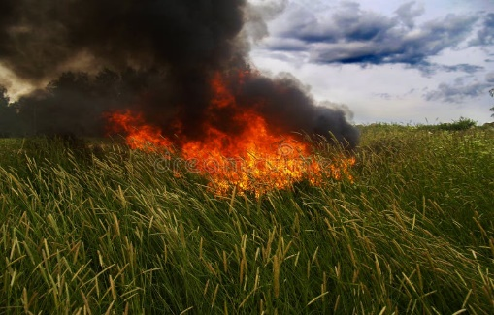
What can you do with a torch?
Light up
Burn something
Keep yourself warm
Defeat an enemy
The key is to use your skills and tools properly and wisely

Slide 11
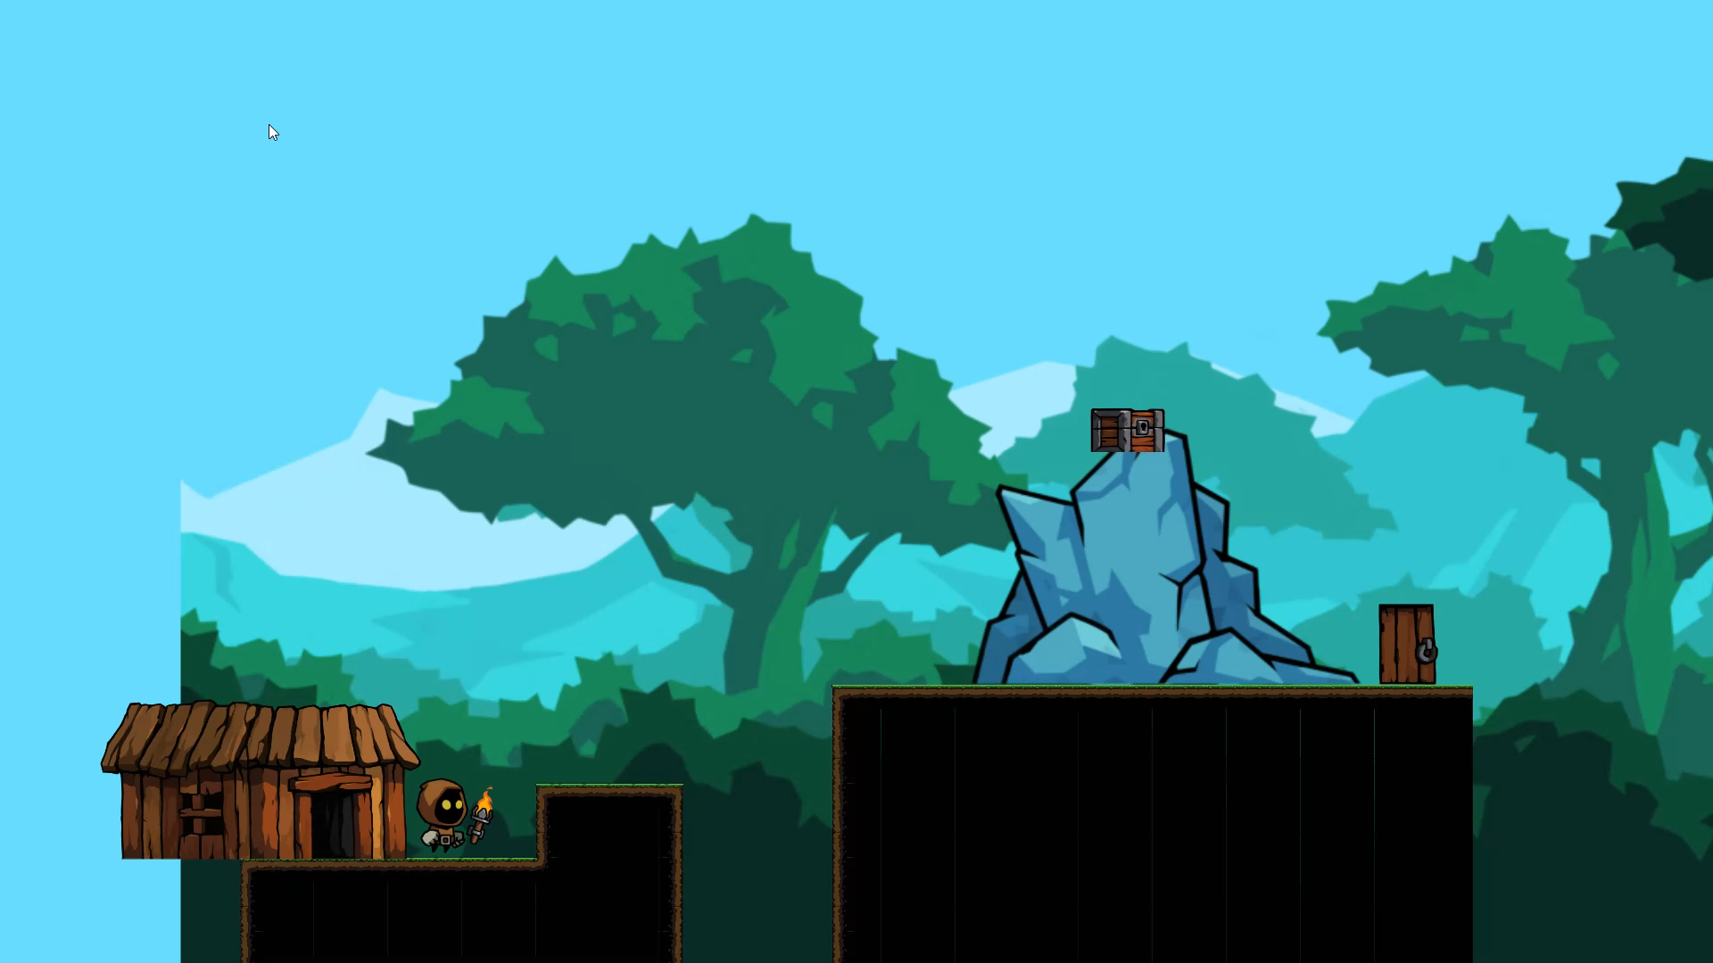
A Demo : Let ice melt with your torch

Slide 12
What’s more…
There are more scenes
More complex, challenging, and interesting puzzles
More tools and skills
More enemies
For you to explore and challenge!

Slide 13
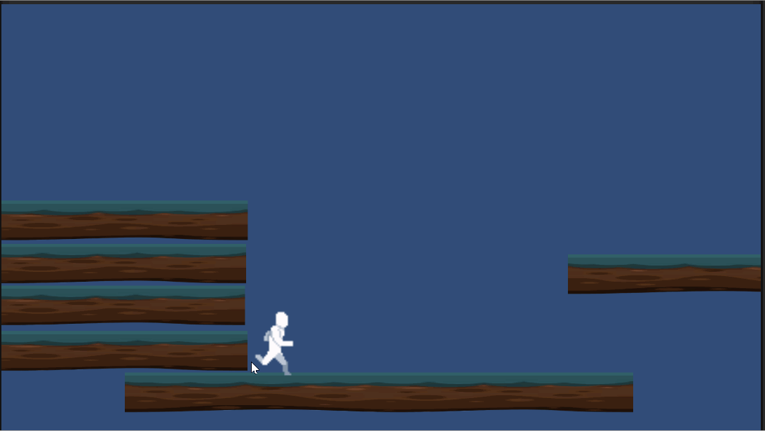

Challenges
More Choices and Visual Trends
Hero’s action
Attacking system
Scene Design
idle, walk, run, jump, attack(hitting,using weapons like guns,arrows)
enemy’s walking behavior, blood, hitting behavior so as our hero.
How to design is the key to make our game funny,good design makes it more interesting

Slide 14
Design Details
Art,structure,background,scale
Scene
Enemy
behavior
special
DESIGN
Something like special buttons ,and melt the ice as it approachs the fire,and so on.
Trap
success
music
Interesting,shocking

Slide 15
Goals
AMAZING Design
Those who play the game will be amazed by the amazing design
AMAZING Story
01
We want to tell a really amazing story in this game. You will experience a complete adventure and enjoy the entire story.
02
03
AMAZING Puzzles
You will get satisfaction when you figure out the well-designed puzzles. You will never feel bored facing various puzzles.

Slide 16
谢谢观看
Thank you

